Slide 1
Installation of ORACLE 11g Release 2 on Windows

Slide 2
Steps of installation
Step 1 : Creating an OTN account
Step 2 : Downloading Oracle 11g
Step 3 : Unzipping Oracle
Step 4 : Installing and Configuring Oracle

Slide 3
Step 1 : Creating an OTN account
Applicable if you want to download the oracle 11g by yourself
Go to http://www.oracle.com/index.html and register for an account of your own.

Slide 4
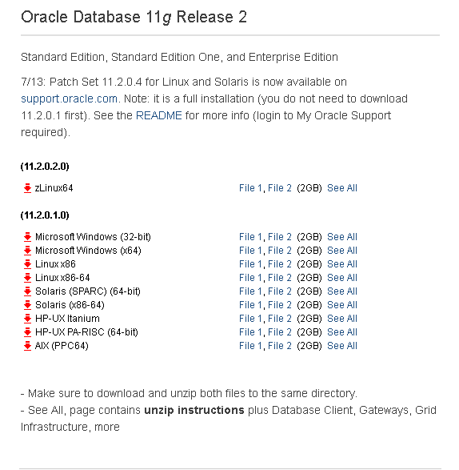
Step 2: Downloading Oracle 11g
Go to the following link
http://www.oracle.com/technetwork/database/enterprise-edition/downloads/index.html?ssSourceSiteId=ocomen
and scroll down to find the screenshot:

Slide 5
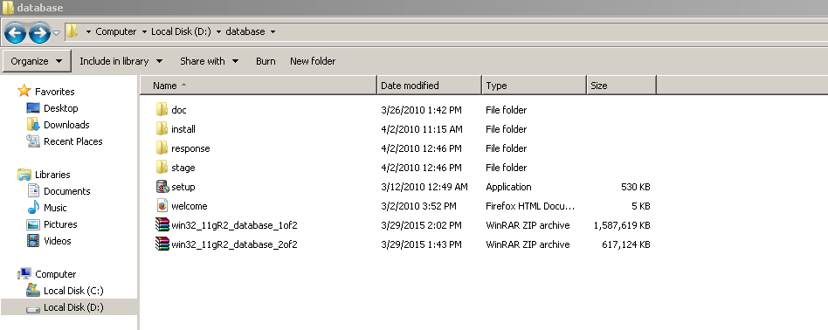
Step 2: Downloading contd.
Download both File 1 and File 2 as per your windows version
Make sure to download and unzip both files to the same directory.

Slide 6
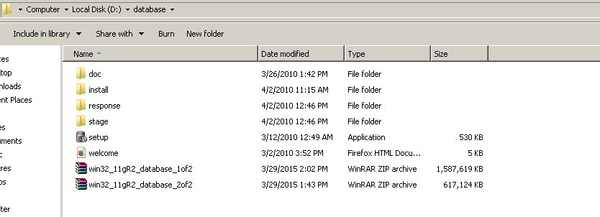
Step 3: Installation
Click on the setup icon to start installation

Slide 7
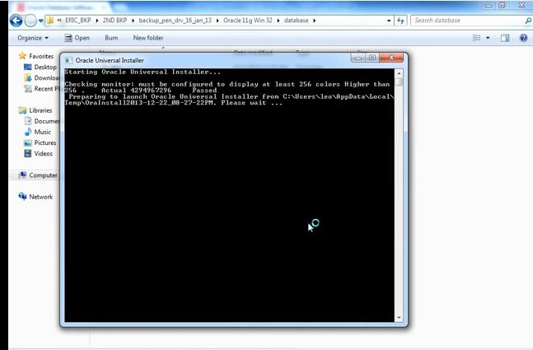
Step 3 : Installation contd.
Installation starts with this window:

Slide 8
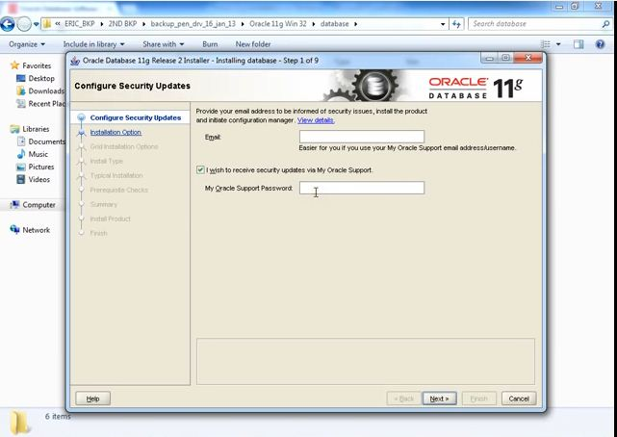
Step 3: Installation Contd.
Give your OTN account username and password here if you want update and then next :
Unmark the tick if you don’t want update

Slide 9
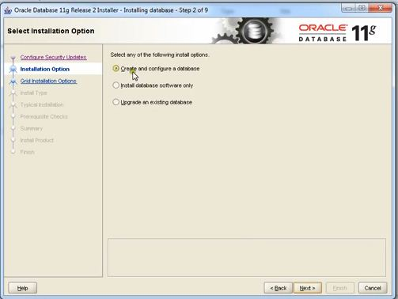
Step 3 : Installation contd.
Choose the create and configure database option and then next:

Slide 10
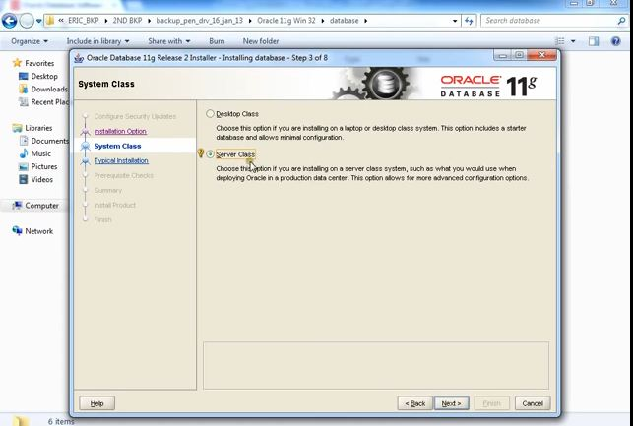
Step 3 : Installation Contd.
Choose Server Class and next:

Slide 11
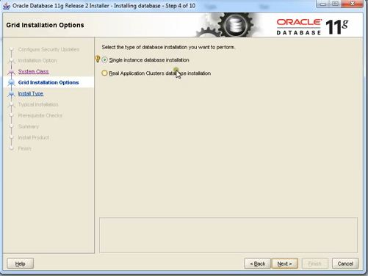
Step 3 : Installation Contd.
Select Single Instance option as grid installation options and press next

Slide 12
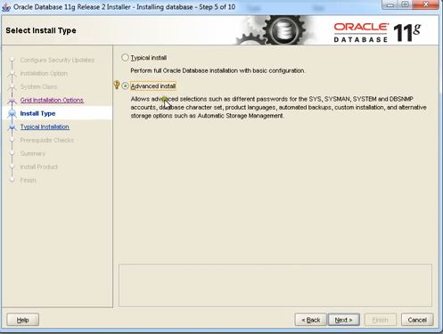
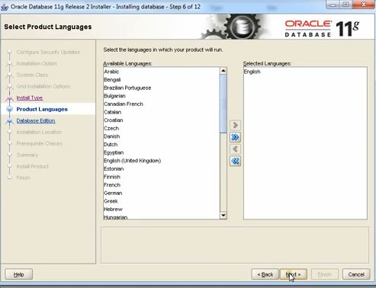
Step 3 : Installation Contd.
Select Advanced Install as install type and then next and later select language

Slide 13
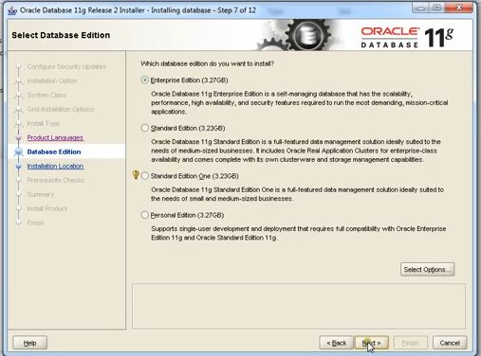
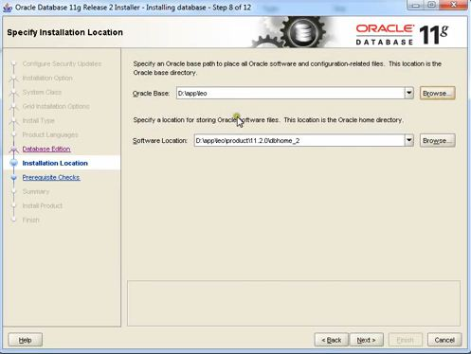
Installation Contd.
Select Enterprise Edition and next, select path as your choice otherwise continue

Slide 14
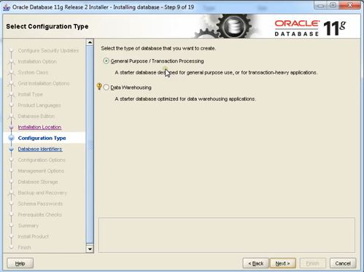
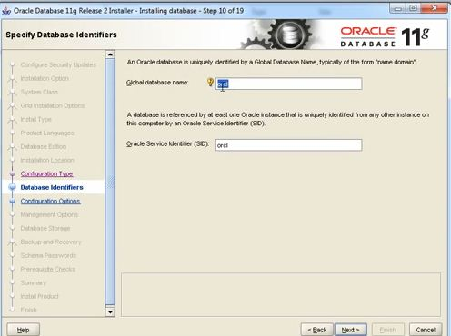
Installation Contd.
Select General Purpose as configuration type, continue set globaldb name if you choice to ; by default set to orcl

Slide 15
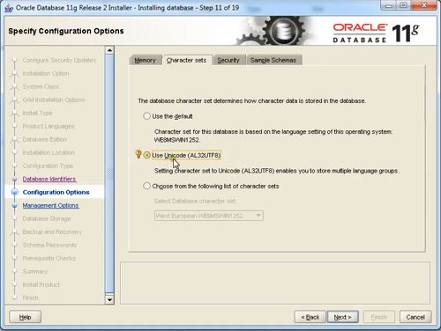
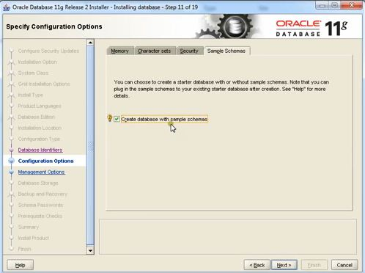
In the next page set the character set as unicode and enable the sample schemas , continue

Slide 16
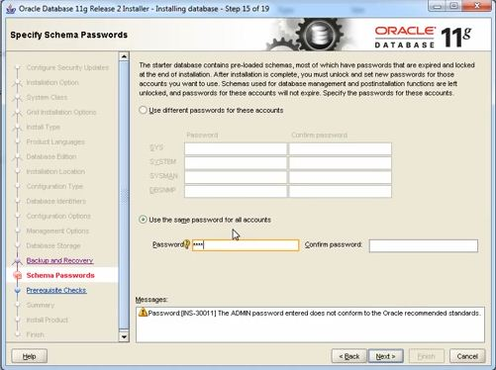
Keep pressing next until you reach Schema Passwords
Select use the same password for all account for your management facility set the password and confirm it and then continue
Then it will automatically do some prerequisite checks and you can check the summary and press finish

Slide 17
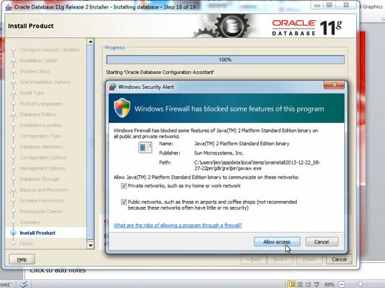
The system will ask for access to two files; you have to just allow them

Slide 18
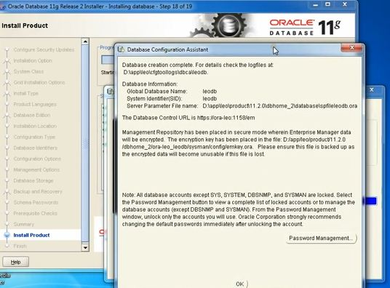
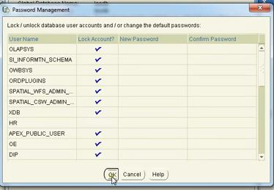
A database assistant window will appear and by selecting password management configure as required(Unlock HR) then press OK for both and then close

Slide 19
Then go to start menu
– oracle-oradb11g_home 1,
Then to Application development
Run Sql Plus
Enter username and password(as set during installation)

Slide 20
Reference
https://www.youtube.com/watch?v=APZbgF_vnBI

